Slide 1

Cryptography & System Security
Ajinkya A. Valanjoo
ajinkya.valanjoo@ves.ac.in
Assistant Professor in VESIT

Slide 2
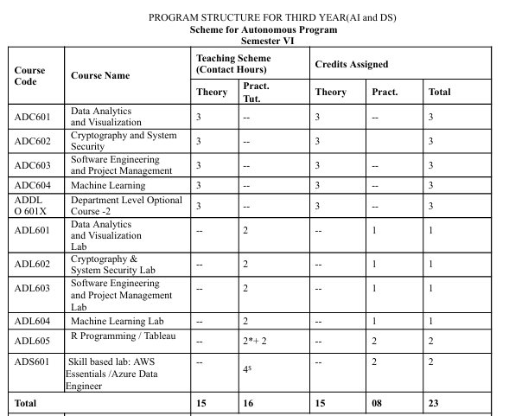

Slide 3
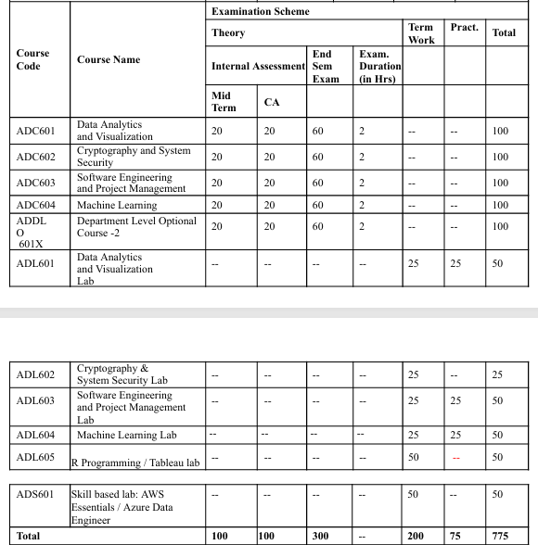

Slide 4
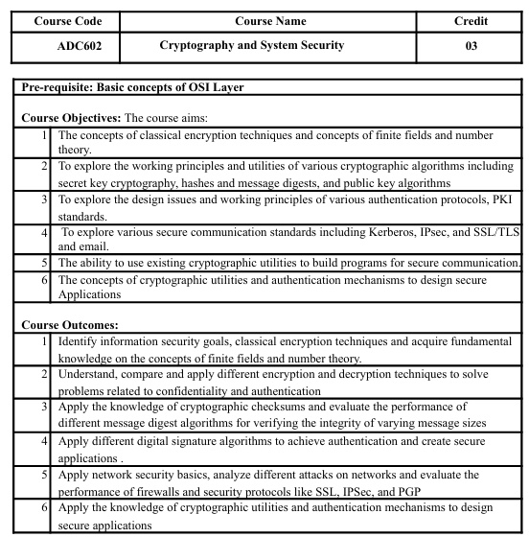

Slide 5
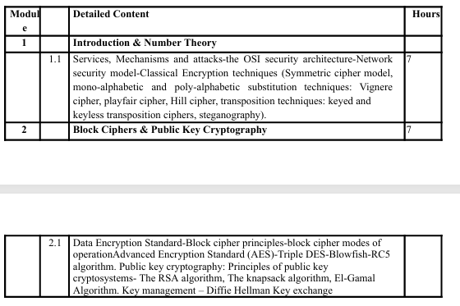

Slide 6
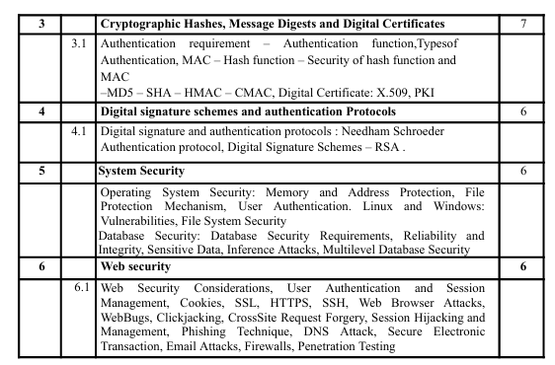

Slide 7
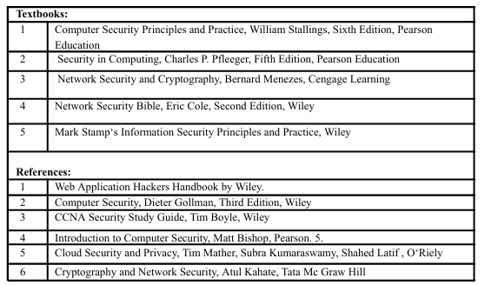

Slide 8
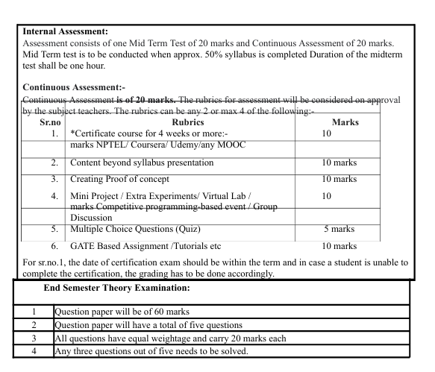

Slide 9
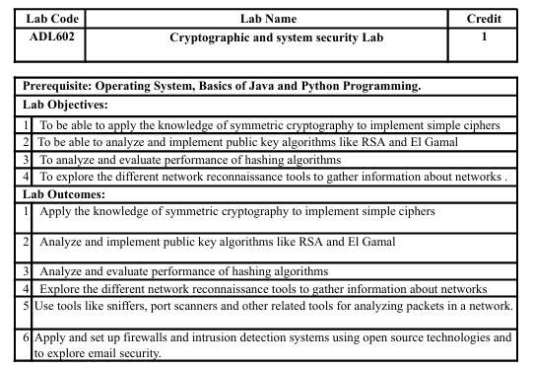

Slide 10
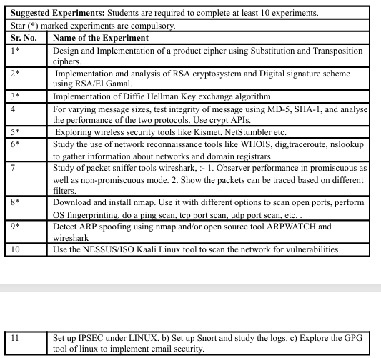

Slide 11
Module No. | Name of Module | Hours | Marks
1 | Introduction & Number Theory | 07 | 18
2 | Block Ciphers & Public Key Cryptography | 07 | 18
3 | Cryptographic Hashes, Message Digests and Digital Certificates | 07 | 18
4 | Digital signature schemes and authentication Protocols | 06 | 16
5 | System Security | 06 | 15
6 | Web security | 06 | 15
Total |  | 39 | 100

Slide 12
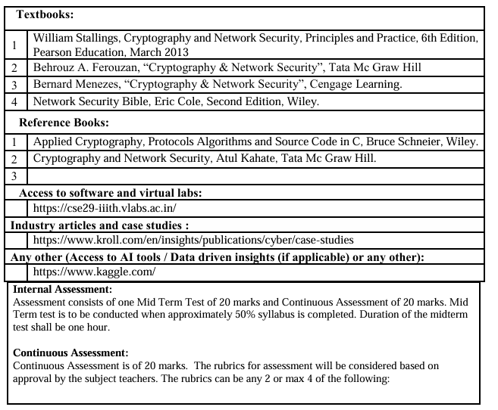

Slide 13
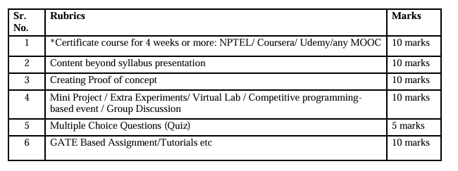

Slide 14
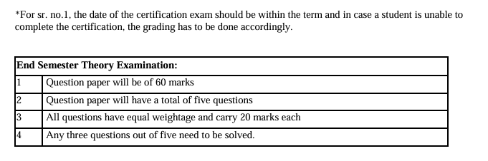

Slide 15
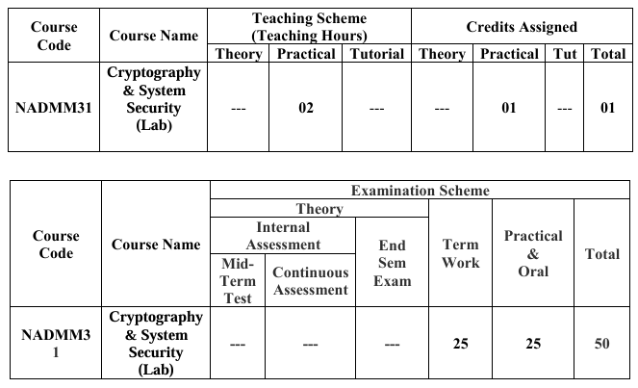

Slide 16
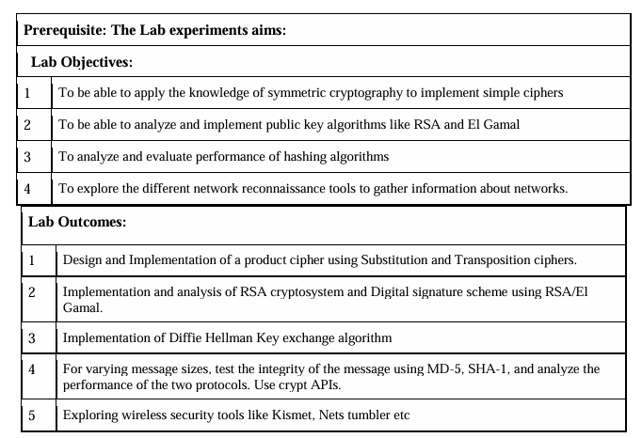

Slide 17
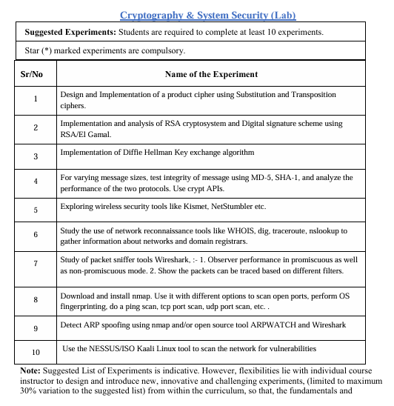

Slide 18
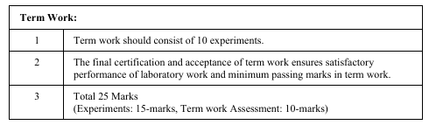

Slide 19
WHAT DOES SECURE MEAN?
SECURITY???

Slide 20
SECURITY GOALS
CONFIDENTIALITY INTEGRITY
SECURE
NON-REPUDIATION

Slide 21
Security Goals
Authentication
Ensures that whoever supplies or accesses sensitive data is an authorized party.
Confidentiality
Assures that only authorized parties are able to understand the data.

Slide 22
..contd.
Integrity
Ensures that when a message is sent over a network, the message that arrives is the same as the message that was originally sent
Nonrepudiation
Ensuring that the intended recipient actually received the message & ensuring that the sender actually sent the message

Slide 23
Aspects of Security
consider 3 aspects of Network security:
security attack
security mechanism (control)
security service
Notes:
The OSI security architecture focuses on security attacks, mechanisms, and services. These can be defined briefly as follows:
• Security attack: Any action that compromises the security of information owned by an organization.
• Security mechanism: A process (or a device incorporating such a process) that is designed to detect, prevent, or recover from a security attack.
• Security service: A processing or communication service that enhances the security of the data processing systems and the information transfers of an organization. The services are intended to counter security attacks, and they make use of one or more security mechanisms to provide the service.
In the literature, the terms threat and attack are commonly used to mean more or less the same thing. Table 1.1 provides definitions taken from RFC 2828, Internet Security Glossary.
Threat - A potential for violation of security, which exists when there is a circumstance, capability, action, or event that could breach security and cause harm. That is, a threat is a possible danger that might exploit a vulnerability.
Attack - An assault on system security that derives from an intelligent threat; that is, an intelligent act that is a deliberate attempt (especially in the sense of a method or technique) to evade security services and violate the security policy of a system.

Slide 24
Classify Security Attacks as
Passive attacks - eavesdropping on, or monitoring of, transmissions to:
obtain message contents, or
monitor traffic flows
Active attacks – modification of data stream to:
masquerade of one entity as some other
replay previous messages
modify messages in transit
denial of service

Slide 25
Alice, Bob, and Darth
Alice is the person who needs to send secure data.
Bob is the recipient of the data.
Darth is the person who somehow disturbs the communication between Alice and Bob.

Slide 26
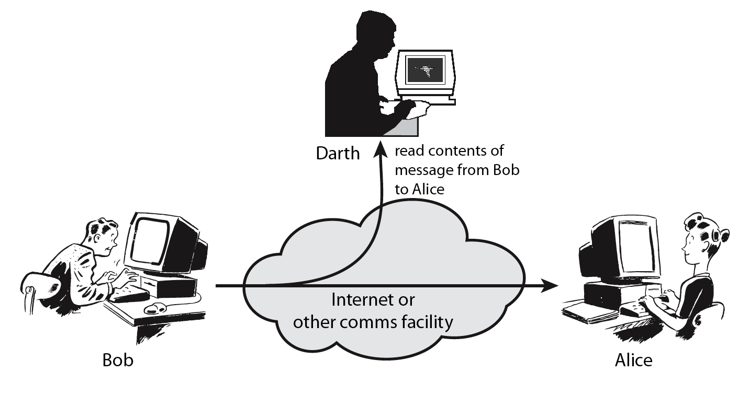
Passive Attack - Interception
Notes:
A useful means of classifying security attacks, used both in X.800 and RFC 2828, is in terms of passive attacks and active attacks. A passive attack attempts to learn or make use of information from the system but does not affect system resources.
Passive attacks are in the nature of eavesdropping on, or monitoring of, transmissions. The goal of the opponent is to obtain information that is being transmitted. Two types of passive attacks are:
+ release of message contents - as shown above in Stallings Figure 1.2a here
+ traffic analysis - monitor traffic flow to determine location and identity of communicating hosts and could observe the frequency and length of messages being exchanged
These attacks are difficult to detect because they do not involve any alteration of the data.

Slide 27
Passive Attack: Traffic Analysis
Observe traffic pattern
Notes:
27
A useful means of classifying security attacks, used both in X.800 and RFC 2828, is in terms of passive attacks and active attacks. A passive attack attempts to learn or make use of information from the system but does not affect system resources.
Passive attacks are in the nature of eavesdropping on, or monitoring of, transmissions. The goal of the opponent is to obtain information that is being transmitted. Two types of passive attacks are:
+ release of message contents - as shown above in Stallings Figure 1.2a here
+ traffic analysis - monitor traffic flow to determine location and identity of communicating hosts and could observe the frequency and length of messages being exchanged
These attacks are difficult to detect because they do not involve any alteration of the data.

Slide 28
Active Attack: Interruption
Block delivery of message
Notes:
28
A useful means of classifying security attacks, used both in X.800 and RFC 2828, is in terms of passive attacks and active attacks. A passive attack attempts to learn or make use of information from the system but does not affect system resources.
Passive attacks are in the nature of eavesdropping on, or monitoring of, transmissions. The goal of the opponent is to obtain information that is being transmitted. Two types of passive attacks are:
+ release of message contents - as shown above in Stallings Figure 1.2a here
+ traffic analysis - monitor traffic flow to determine location and identity of communicating hosts and could observe the frequency and length of messages being exchanged
These attacks are difficult to detect because they do not involve any alteration of the data.

Slide 29
Active Attack: Fabrication
Fabricate message
Notes:
29
A useful means of classifying security attacks, used both in X.800 and RFC 2828, is in terms of passive attacks and active attacks. A passive attack attempts to learn or make use of information from the system but does not affect system resources.
Passive attacks are in the nature of eavesdropping on, or monitoring of, transmissions. The goal of the opponent is to obtain information that is being transmitted. Two types of passive attacks are:
+ release of message contents - as shown above in Stallings Figure 1.2a here
+ traffic analysis - monitor traffic flow to determine location and identity of communicating hosts and could observe the frequency and length of messages being exchanged
These attacks are difficult to detect because they do not involve any alteration of the data.

Slide 30
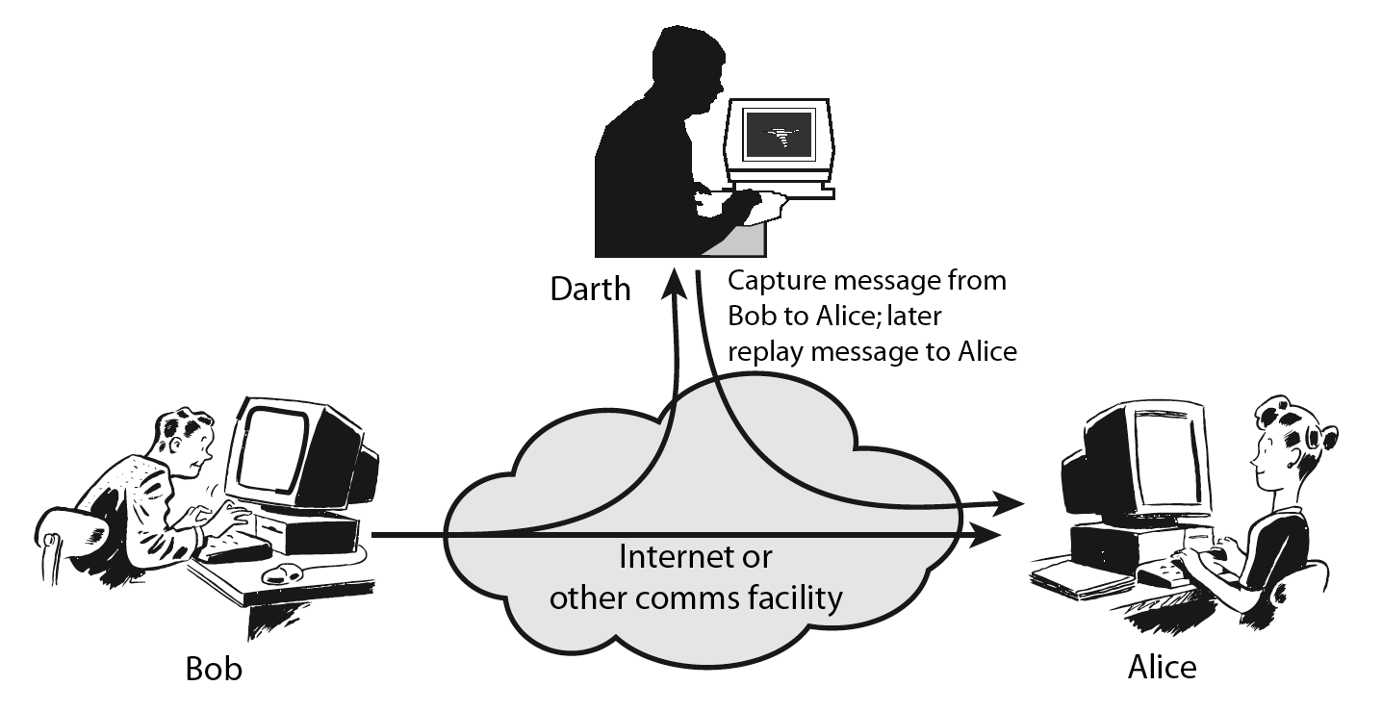
Active Attack: Replay
Notes:
Active attacks involve some modification of the data stream or the creation of a false stream and can be subdivided into four categories: masquerade, replay, modification of messages, and denial of service:
masquerade of one entity as some other
replay previous messages (as shown above in Stallings Figure 1.3b)
modify/alter (part of) messages in transit to produce an unauthorized effect
denial of service - prevents or inhibits the normal use or management of communications facilities
Active attacks present the opposite characteristics of passive attacks. Whereas passive attacks are difficult to detect, measures are available to prevent their success. On the other hand, it is quite difficult to prevent active attacks absolutely, because of the wide variety of potential physical, software, and network vulnerabilities. Instead, the goal is to detect active attacks and to recover from any disruption or delays caused by them.

Slide 31
Active Attack: Modification
Modify message
Notes:
31
Active attacks involve some modification of the data stream or the creation of a false stream and can be subdivided into four categories: masquerade, replay, modification of messages, and denial of service:
masquerade of one entity as some other
replay previous messages (as shown above in Stallings Figure 1.3b)
modify/alter (part of) messages in transit to produce an unauthorized effect
denial of service - prevents or inhibits the normal use or management of communications facilities
Active attacks present the opposite characteristics of passive attacks. Whereas passive attacks are difficult to detect, measures are available to prevent their success. On the other hand, it is quite difficult to prevent active attacks absolutely, because of the wide variety of potential physical, software, and network vulnerabilities. Instead, the goal is to detect active attacks and to recover from any disruption or delays caused by them.

Slide 32
Handling Attacks
Passive attacks – focus on Prevention
Easy to stop
Hard to detect
Active attacks – focus on Detection and Recovery
Hard to stop
Easy to detect
Notes:
Consider the role of a security service, and what may be required.
Note both similarities and differences with traditional paper documents, which for example:
have signatures & dates;
need protection from disclosure, tampering, or destruction;
may be notarized or witnessed;
may be recorded or licensed

Slide 33
Security Services
Authentication - assurance that the communicating entity is the one claimed
Access Control - prevention of the unauthorized use of a resource
Data Confidentiality –protection of data from unauthorized disclosure
Data Integrity - assurance that data received is as sent by an authorized entity
Non-Repudiation - protection against denial by one of the parties in a communication
Notes:
See Table 1.4 for details of the 5 Security Service categories and the 14 specific services.

Slide 34
Security Mechanisms
Distinguishes between two mechanisms
reversible encipherment mechanism: A reversible cryptographic mechanism is simply an encryption algorithm that allows data to be encrypted and subsequently decrypted. Irreversible cryptographic mechanisms include hash algorithms and message authentication codes, which are used in digital signature and message authentication applications.
Irreversible encipherment mechanisms: Irreversible encipherment mechanisms include hash algo-rithms and message authentication codes, which are used in digital signature and message authentication applications.

Slide 35
Security Mechanisms
Specific security mechanisms:
Encipherment
Digital signatures
Access controls
Data integrity
Authentication exchange
Traffic padding
Routing control
Notarization
Pervasive security mechanisms:
Trusted functionality
Security labels
Event detection
Security audit trails
Security recovery
Notes:
see Table 1.5 for details of these mechanisms, and Table 1.6 for the relationship between services and mechanisms.
The “specific security mechanisms” are protocol layer specific, whilst the “pervasive security mechanisms” are not.
Will meet some of these mechanisms in much greater detail later.

Slide 36
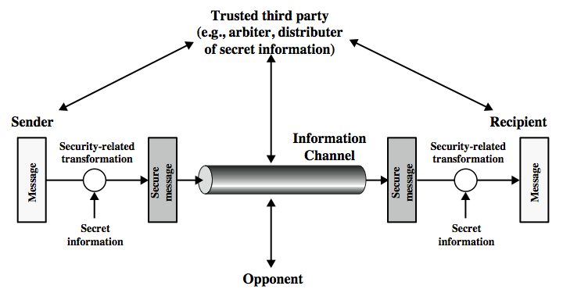
Model for Network Security
Notes:
In considering the place of encryption, its useful to use the following two models from Stallings section 1.6.
The first, illustrated in Figure 1.4, models information being transferred from one party to another over an insecure communications channel, in the presence of possible opponents. The two parties, who are the principals in this transaction, must cooperate for the exchange to take place. They can use an appropriate security transform (encryption algorithm), with suitable keys, possibly negotiated using the presence of a trusted third party. Parts One through Four of this book concentrates on the types of security mechanisms and services that fit into the model shown here.

Slide 37
Model for Network Security
using this model requires us to:
design a suitable algorithm for the security transformation
generate the secret information (keys) used by the algorithm
develop methods to distribute and share the secret information
specify a protocol enabling the principals to use the transformation and secret information for a security service
Notes:
This general model shows that there are four basic tasks in designing a particular security service, as listed.

Slide 38
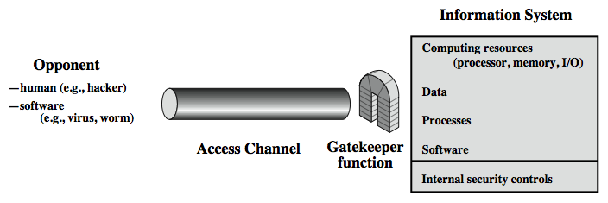
Model for Network Access Security
Notes:
The second, illustrated in Figure 1.5, model is concerned with controlled access to information or resources on a computer system, in the presence of possible opponents. Here appropriate controls are needed on the access to and within the system, to provide suitable security.
The security mechanisms needed to cope with unwanted access fall into two broad categories (as shown in this figure). The first category might be termed a gatekeeper function. It includes password-based login procedures that are designed to deny access to all but authorized users and screening logic that is designed to detect and reject worms, viruses, and other similar attacks. Once either an unwanted user or unwanted software gains access, the second line of defense consists of a variety of internal controls that monitor activity and analyze stored information in an attempt to detect the presence of unwanted intruders. These issues are explored in Part Four.

Slide 39
Model for Network Access Security
using this model requires us to:
select appropriate gatekeeper functions to identify users
implement security controls to ensure only authorised users access designated information or resources
Notes:
Detail here the tasks needed to use this model.

Slide 40
cryptography

Slide 41
Definition

Slide 42
cryptography
A word with Greek origins, means “secret writing”.
The term to refer to the science and art of transforming messages to make them secure and immune to attacks.
Applications of cryptography includes ATM cards, computer passwords, and electronic commerce.

Slide 43
Cryptography Issues

Slide 44
Cryptography Issues
Confidentiality: Only sender, intended receiver should “understand” message contents.
End-Point Authentication: Sender and receiver want to confirm identity of each other.
Message Integrity: Sender and receiver want to ensure message not altered (in transit, or afterwards) without detection.
Message Nonrepudiation: Message nonrepudiation means that a sender must not be able to deny sending a message that he or she, in fact, did send.
Entity Authentication: In entity authentication (or user identification) the entity or user is verified prior to access to the system resources

Slide 45
Cryptography components

Slide 46
Plaintext and Ciphertext
The original message, before being transformed, is called plaintext.
After the message is transformed, it is called ciphertext.
An encryption algorithm transforms the plaintext into ciphertext; a decryption algorithm transforms the ciphertext back into plaintext.
Example:
Plaintext: HELLO
Ciphertext: KHOOR

Slide 47
Cipher
Encryption and Decryption algorithms are referred as ciphers.
Also used to refer to different categories of algorithms in cryptography.
Example (Traditional Substitution Ciphers):
Monoalphabetic cipher
Polyalphabetic cipher
Plaintext: HELLO
Ciphertext: ABNZF

Slide 48
key
A key is a number (or a set of numbers) that the cipher operates on, as an algorithm.
To encrypt a message, we need an encryption algorithm, an encryption key, and the plaintext.
To decrypt a message, we need a decryption algorithm, a decryption key, and the ciphertext. These reveal the original plaintext.
Types:
Shared key, Public key and Private key.

Slide 49
Use of Key
Example:
Use Monoalphabetic Cipher to encrypt “HELLO” with key = 3.
Plaintext: HELLO
Ciphertext: KHOOR

Slide 50
Cryptography Categories

Slide 51
Cryptography Categories
We can divide all the cryptography algorithms (ciphers) into two groups:
Symmetric key (also called secret-key) cryptography algorithms and
Asymmetric key (also called public-key) cryptography algorithms.

Slide 52
Symmetric key cryptography
In symmetric-key cryptography, the same key is used by both parties.
The sender uses this key and an encryption algorithm to encrypt data; the receiver uses the same key and the corresponding decryption algorithm to decrypt the data.

Slide 53
Symmetric key Ciphers
Traditional
Ciphers
Modern
Ciphers
Substitution
Ciphers
Transposition
Ciphers
Simple
Ciphers
Round
Ciphers
Mono-alphabetic
Ciphers
Poly-alphabetic
Ciphers
XOR, Rotation, S-box, P-box etc.
DES, AES, IDEA, CAST, RC4, RC5, etc.

Slide 54
asymmetric key cryptography
In asymmetric or public-key cryptography, there are two keys: a private key and a public key.
The private key is kept by the receiver.
The public key is announced to the public.
If Alice wants to send a message to Bob, Alice uses the public key to encrypt the message. When the message is received by Bob, the private key is used to decrypt the message.
Some of the asymmetric algorithms are:
Diffie-Hellman, RSA, El Gamal, Elliptic Curve Cryptography (ECC), Man-in-the-Middle Attack etc.

Slide 55
Comparison of Symmetric and Asymmetric key cryptography

Slide 56
Symmetric key cryptography
Asymmetric key cryptography
Only 1 shared key is involved.
The same key encrypts and decrypts the plaintext.
The shared key is kept secret between Alice and Bob.
Examples of Symmetric algorithms:
DES, 3DES, AES, IDEA, BLOWFISH, TWOFISH, RC4, RC5, SAFER etc.
Here 2 keys : a private and a public key are involved.
The Public key encrypts the plaintext while the private key decrypts it.
The private key is just kept secret by the Bob while the public key is made public.
Examples of Asymmetric algorithms:
Diffie-Hellman, RSA, El Gamal, Elliptic Curve Cryptography (ECC) etc.

Slide 57
Cryptanalysis
objective to recover key not just message
general approaches:
cryptanalytic attack
brute-force attack
Notes:
Typically objective is to recover the key in use rather then simply to recover the plaintext of a single ciphertext.
There are two general approaches:
Cryptanalytic attacks rely on the nature of the algorithm plus perhaps some knowledge of the general characteristics of the plaintext or even some sample plaintext-ciphertext pairs.
Brute-force attacks try every possible key on a piece of ciphertext until an intelligible translation into plaintext is obtained. On average,half of all possible keys must be tried to achieve success.

Slide 58
Cryptanalytic Attacks
ciphertext only
only know algorithm & ciphertext, is statistical, know or can identify plaintext
known plaintext
know/suspect plaintext & ciphertext
chosen plaintext
select plaintext and obtain ciphertext
chosen ciphertext
select ciphertext and obtain plaintext
chosen text
select plaintext or ciphertext to en/decrypt
Notes:
Stallings Table 2.1 summarizes the various types of cryptanalytic attacks, based on the amount of information known to the cryptanalyst, from least to most. The most difficult problem is presented when all that is available is the ciphertext only. In some cases, not even the encryption algorithm is known, but in general we can assume that the opponent does know the algorithm used for encryption. Then with increasing information have the other attacks. Generally, an encryption algorithm is designed to withstand a known-plaintext attack.

Slide 59
Section 2
Mathematics of Cryptography
Part I: Integer, Modular Arithmetic, Congruence,
and Matrices

Slide 60
2-1 INTEGER ARITHMETIC
In integer arithmetic, we use a set and a few operations. You are familiar with this set and the corresponding operations, but they are reviewed here to create a background for modular arithmetic.
Topics discussed in this section:
2.1.1 Set of Integers 2.1.2 Binary Operations 2.1.3 Integer Division
2.1.4 Divisibility
2.1.5 Linear Diophantine Equations

Slide 61
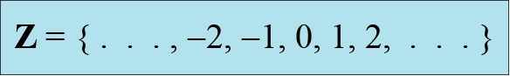
2.1.1 Set of Integers
The set of integers, denoted by Z, contains all integral numbers (with no fraction) from negative infinity to positive infinity (Figure 2.1).
Figure 2.1 The set of integers

Slide 62
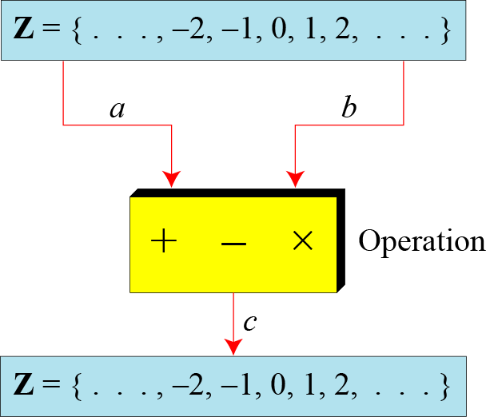
2.1.2 Binary Operations
In cryptography, we are interested in three binary operations applied to the set of integers. A binary operation takes two inputs and creates one output.
Figure 2.2 Three binary operations for the set of integers

Slide 63
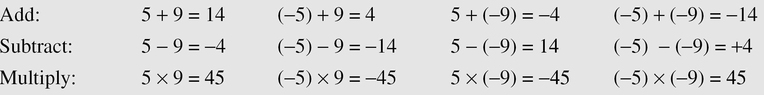
2.1.2 Continued
Example 2.1
The following shows the results of the three binary operations on two integers. Because each input can be either positive or negative, we can have four cases for each operation.

Slide 64
2.1.3 Integer Division
In integer arithmetic, if we divide a by n, we can get q And r . The relationship between these four integers can be shown as
a = q × n + r

Slide 65
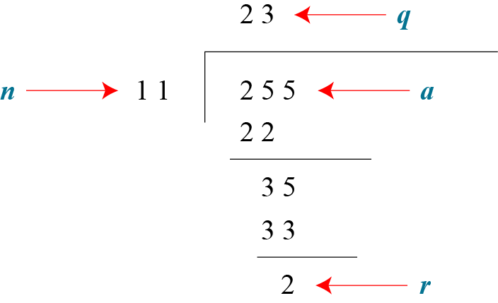
2.1.3 Continued
Example 2.2
Assume that a = 255 and n = 11. We can find q = 23 and R = 2 using the division algorithm.
Figure 2.3 Example 2.2, finding the quotient and the remainder

Slide 66
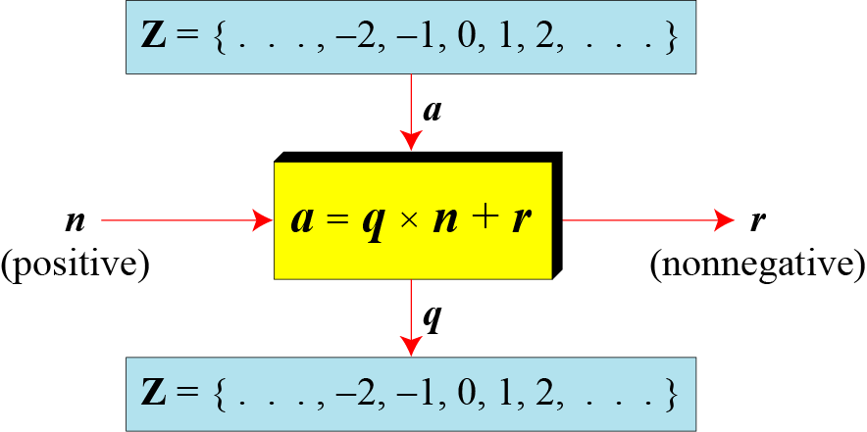
2.1.3 Continued
Figure 2.4 Division algorithm for integers

Slide 67
2.1.3 Continued
Example 2.3
When we use a computer or a calculator, r and q are negative when a is negative. How can we apply the restriction that r needs to be positive? The solution is simple, we decrement the value of q by 1 and we add the value of n to r to make it positive.

Slide 68
2.1.4 Divisbility
If a is not zero and we let r = 0 in the division relation, we get
a = q × n
If the remainder is zero,
If the remainder is not zero,

Slide 69
2.1.4 Continued
Example 2.4
The integer 4 divides the integer 32 because 32 = 8 × 4. We show this as
b. The number 8 does not divide the number 42 because
42 = 5 × 8 + 2. There is a remainder, the number 2, in the equation. We show this as

Slide 70
2.1.4 Continued
Properties
Property 1: if a|1, then a = ±1.
Property 2: if a|b and b|a, then a = ±b.
Property 3: if a|b and b|c, then a|c.
Property 4: if a|b and a|c, then a|(m × b + n × c), where m and n are arbitrary integers

Slide 71
2.1.4 Continued
Example 2.5

Slide 72
2.1.4 Continued
Example 2.6

Slide 73

2.1.4 Continued
Note
Fact 1: The integer 1 has only one divisor, itself.
Fact 2: Any positive integer has at least
two divisors, 1 and itself (but it can have more).

Slide 74
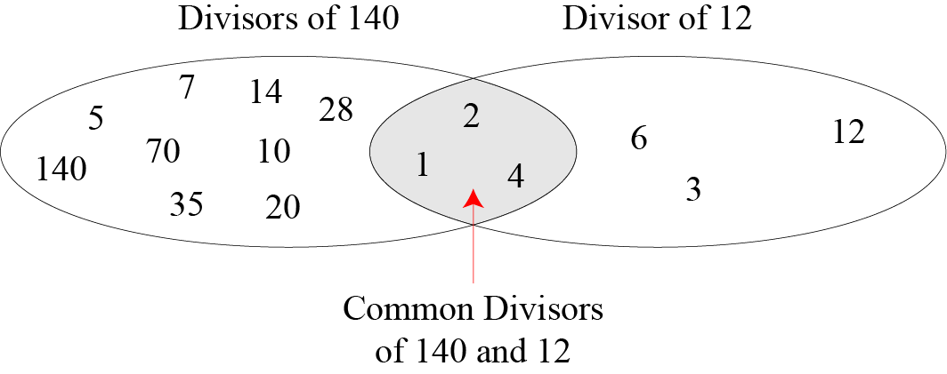
2.1.4 Continued
Figure 2.6 Common divisors of two integers

Slide 75
2.1.4 Continued
Note
Greatest Common Divisor
The greatest common divisor of two positive integers is the largest integer that can divide both integers.
Note
Euclidean Algorithm
Fact 1: gcd (a, 0) = a Fact 2: gcd (a, b) = gcd (b, r), where r is the remainder of dividing a by b

Slide 76
2.1.4 Continued
Note
When gcd (a, b) = 1, we say that a and b are relatively prime.

Slide 77
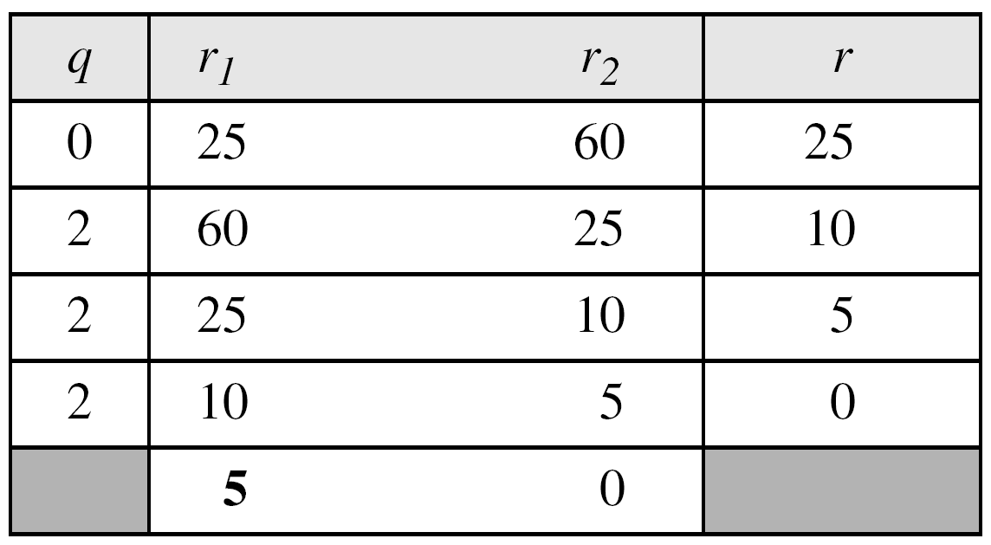
2.1.4 Continued
Example 2.8
Find the greatest common divisor of 25 and 60.
Solution
We have gcd (25, 65) = 5.

Slide 78
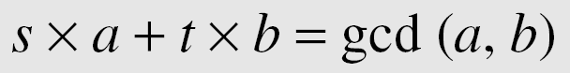
2.1.4 Continued
Extended Euclidean Algorithm
Given two integers a and b, we often need to find other two integers, s and t, such that
The extended Euclidean algorithm can calculate the gcd (a, b) and at the same time calculate the value of s and t.

Slide 79
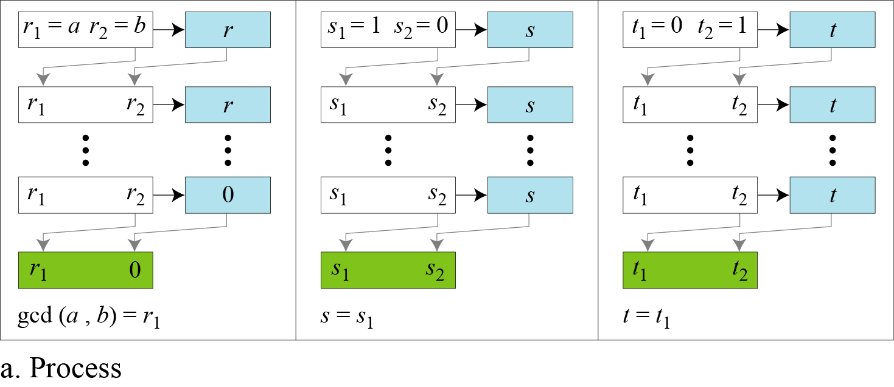
2.1.4 Continued
Figure 2.8.a Extended Euclidean algorithm, part a

Slide 80
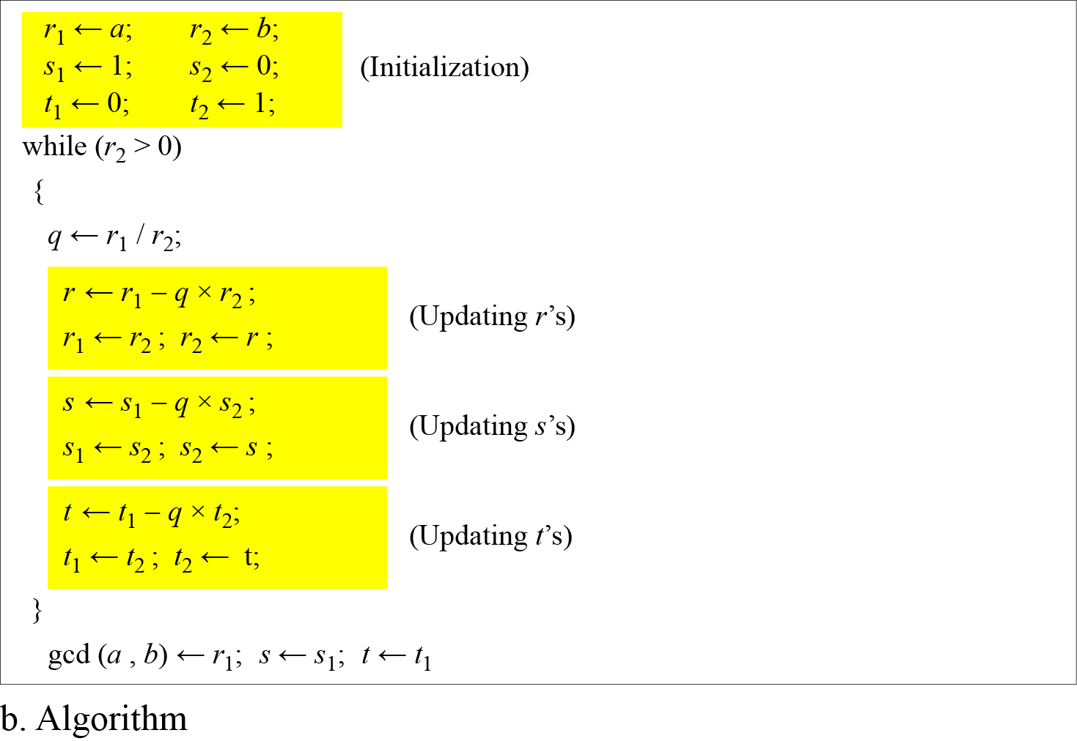
2.1.4 Continued
Figure 2.8.b Extended Euclidean algorithm, part b

Slide 81
2.1.4 Continued
Example 2.9
Given a = 161 and b = 28, find gcd (a, b) and the values of s and t.
Solution
We get gcd (161, 28) = 7, s = −1 and t = 6.

Slide 82
2.1.4 Continued
Example 2.10
Given a = 17 and b = 0, find gcd (a, b) and the values of s and t.
Solution
We get gcd (17, 0) = 17, s = 1, and t = 0.

Slide 83
2.1.4 Continued
Example 2.11
Given a = 0 and b = 45, find gcd (a, b) and the values of s and t.
Solution
We get gcd (0, 45) = 45, s = 0, and t = 1.

Slide 84
2.1.4 Continued
Linear Diophantine Equation
Note
A linear Diophantine equation of two variables is ax + by = c.

Slide 85
2.1.4 Continued
Linear Diophantine Equation
Note
Particular solution: x₀ = (c/d)s and y₀ = (c/d)t
Note
General solutions:
x = x₀ + k (b/d) and y = y₀ − k(a/d) where k is an integer

Slide 86
2.1.4 Continued
Example 2.12
Find the particular and general solutions to the equation
21x + 14y = 35.
Solution

Slide 87
2-2 MODULAR ARITHMETIC
The division relationship (a = q × n + r) discussed in the previous section has two inputs (a and n) and two outputs (q and r). In modular arithmetic, we are interested in only one of the outputs, the remainder r.
Topics discussed in this section:
2.2.1 Modular Operator 2.2.2 Set of Residues 2.2.3 Congruence 2.2.4 Operations in Z_{n}
2.2.5 Addition and Multiplication Tables
2.2.6 Different Sets

Slide 88
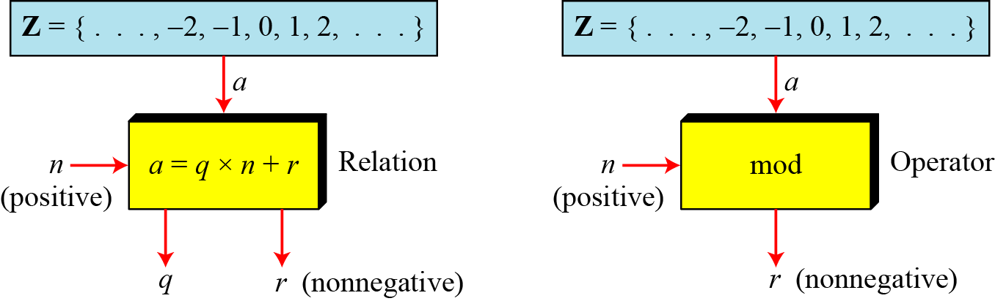
2.2.1 Modulo Operator
The modulo operator is shown as mod. The second input (n) is called the modulus. The output r is called the residue.
Figure 2.9 Division algorithm and modulo operator

Slide 89
2.1.4 Continued
Example 2.14
Find the result of the following operations:
a. 27 mod 5 b. 36 mod 12
c. −18 mod 14 d. −7 mod 10
Solution
Dividing 27 by 5 results in r = 2
Dividing 36 by 12 results in r = 0.
c. Dividing −18 by 14 results in r = −4. After adding the modulus r = 10
d. Dividing −7 by 10 results in r = −7. After adding the modulus to −7, r = 3.

Slide 90
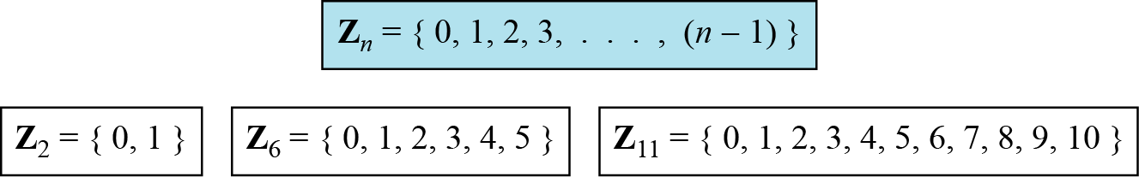
2.2.2 Set of Residues
The modulo operation creates a set, which in modular arithmetic is referred to as the set of least residues modulo n, or Z_{n}.
Figure 2.10 Some Z_{n} sets

Slide 91
2.2.3 Congruence
To show that two integers are congruent, we use the congruence operator ( ≡ ). For example, we write:

Slide 92
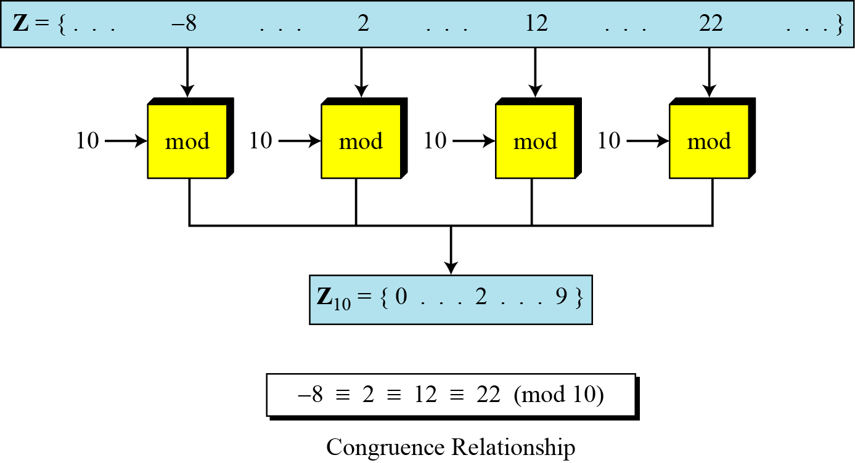
2.2.3 Continued
Figure 2.11 Concept of congruence

Slide 93
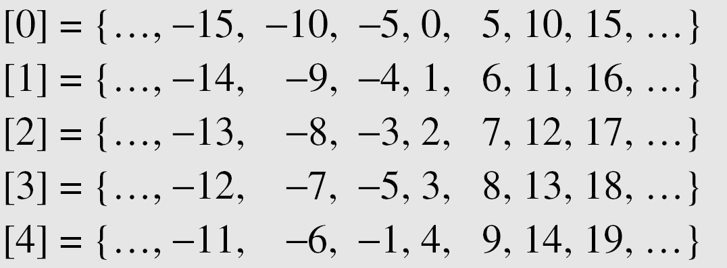
2.2.3 Continued
Residue Classes
A residue class [a] or [a]_{n} is the set of integers congruent modulo n.

Slide 94
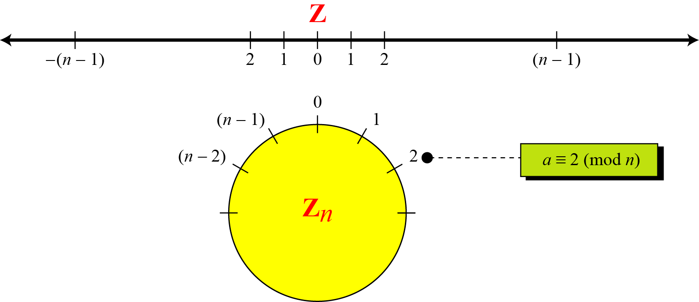
2.2.3 Continued
Figure 2.12 Comparison of Z and Z_{n} using graphs

Slide 95
2.2.3 Continued
Example 2.15
We use modular arithmetic in our daily life; for example, we use a clock to measure time. Our clock system uses modulo 12 arithmetic. However, instead of a 0 we use the number 12.

Slide 96
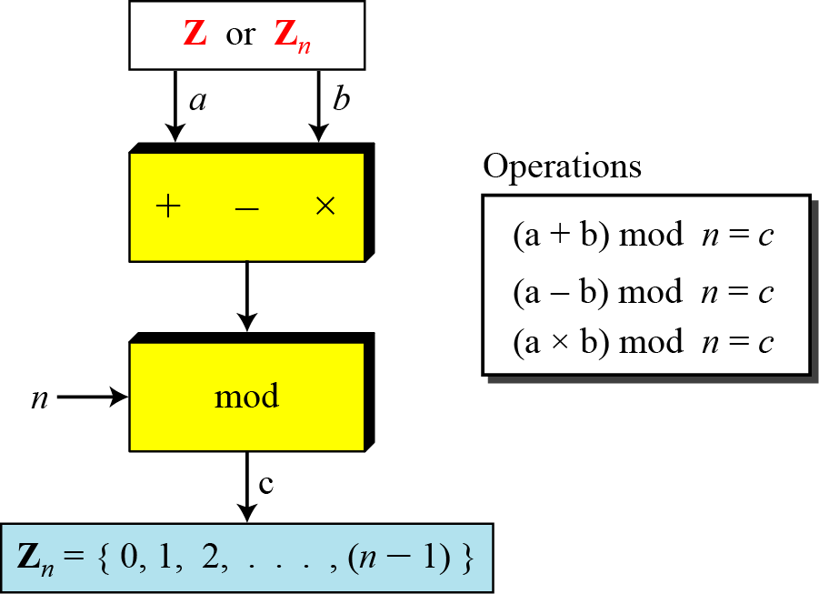
2.2.4 Operation in Z_{n}
The three binary operations that we discussed for the set Z can also be defined for the set Zn. The result may need to be mapped to Zn using the mod operator.
Figure 2.13 Binary operations in Z_{n}

Slide 97
2.2.4 Continued
Example 2.16
Perform the following operations (the inputs come from Zn):
a. Add 7 to 14 in Z15.
b. Subtract 11 from 7 in Z13.
c. Multiply 11 by 7 in Z20.
Solution

Slide 98
2.2.4 Continued
Example 2.17
Perform the following operations (the inputs come from either Z or Z_{n}):
a. Add 17 to 27 in Z₁₄.
b. Subtract 43 from 12 in Z₁₃.
c. Multiply 123 by −10 in Z₁₉.
Solution

Slide 99
2.2.4 Continued
Properties

Slide 100
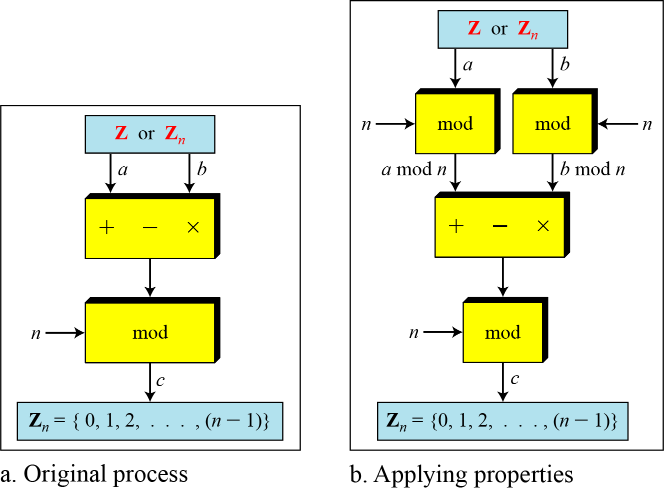
2.2.4 Continued
Figure 2.14 Properties of mode operator

Slide 101
2.2.4 Continued
Example 2.18
The following shows the application of the above properties:
1. (1,723,345 + 2,124,945) mod 11 = (8 + 9) mod 11 = 6
2. (1,723,345 − 2,124,945) mod 16 = (8 − 9) mod 11 = 10
3. (1,723,345 × 2,124,945) mod 16 = (8 × 9) mod 11 = 6

Slide 102
2.2.4 Continued
Example 2.19
In arithmetic, we often need to find the remainder of powers of 10 when divided by an integer.

Slide 103
2.2.4 Continued
Example 2.20
We have been told in arithmetic that the remainder of an integer divided by 3 is the same as the remainder of the sum of its decimal digits. We write an integer as the sum of its digits multiplied by the powers of 10.

Slide 104
2.2.5 Inverses
When we are working in modular arithmetic, we often need to find the inverse of a number relative to an operation. We are normally looking for an additive inverse (relative to an addition operation) or a multiplicative inverse (relative to a multiplication operation).

Slide 105
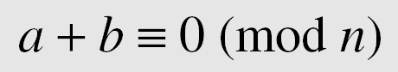
2.2.5 Continue
Additive Inverse
In Z_{n}, two numbers a and b are additive inverses of each other if
Note
In modular arithmetic, each integer has an additive inverse. The sum of an integer and its additive inverse is congruent to 0 modulo n.

Slide 106
2.2.5 Continued
Example 2.21
Find all additive inverse pairs in Z10.
Solution
The six pairs of additive inverses are (0, 0), (1, 9), (2, 8), (3, 7), (4, 6), and (5, 5).

Slide 107
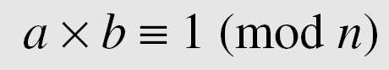
2.2.5 Continue
Multiplicative Inverse
In Z_{n}, two numbers a and b are the multiplicative inverse of each other if
Note
In modular arithmetic, an integer may or may not have a multiplicative inverse.
When it does, the product of the integer and its multiplicative inverse is congruent to 1 modulo n.

Slide 108
2.2.5 Continued
Example 2.22
Find the multiplicative inverse of 8 in Z₁₀.
Solution
There is no multiplicative inverse because gcd (10, 8) = 2 ≠ 1. In other words, we cannot find any number between 0 and 9 such that when multiplied by 8, the result is congruent to 1.
Example 2.23
Find all multiplicative inverses in Z₁₀.
Solution
There are only three pairs: (1, 1), (3, 7) and (9, 9). The numbers 0, 2, 4, 5, 6, and 8 do not have a multiplicative inverse.

Slide 109
2.2.5 Continued
Example 2.24
Find all multiplicative inverse pairs in Z₁₁.
Solution
We have seven pairs: (1, 1), (2, 6), (3, 4), (5, 9), (7, 8), (9, 9), and (10, 10).

Slide 110
2.2.5 Continued
Note
The extended Euclidean algorithm finds the multiplicative inverses of b in Z_{n} when n and b are given and
gcd (n, b) = 1.
The multiplicative inverse of b is the value of t after being mapped to Z_{n}.

Slide 111
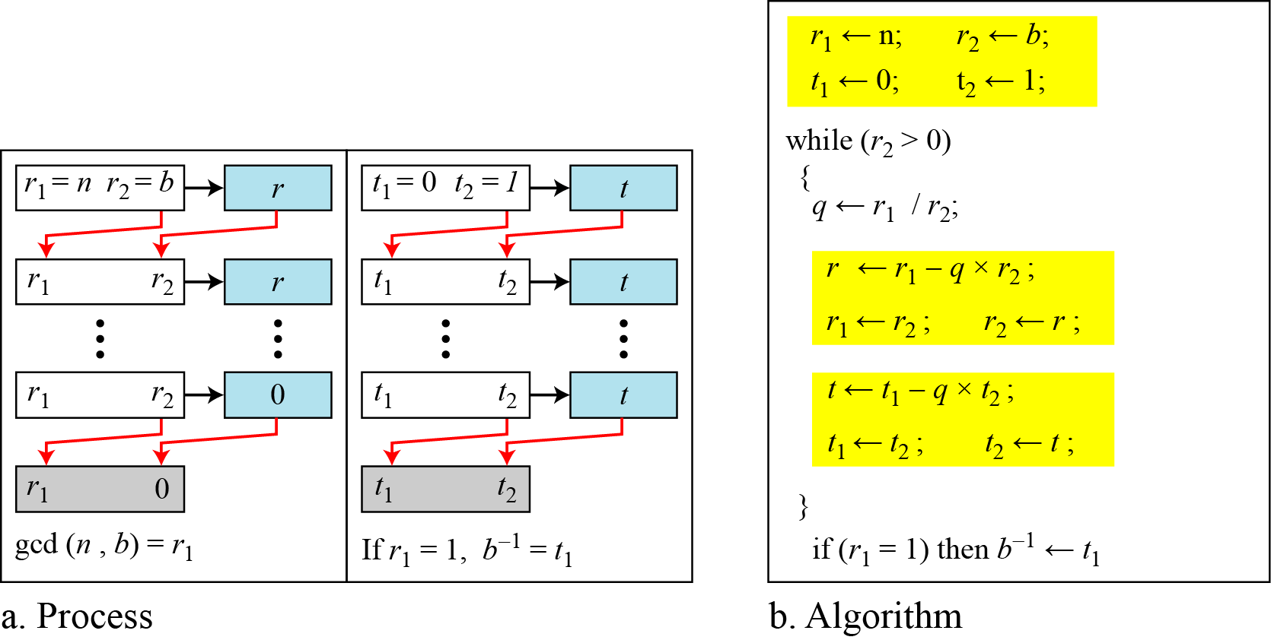
2.2.5 Continued
Figure 2.15 Using extended Euclidean algorithm to find multiplicative inverse

Slide 112
2.2.5 Continued
Example 2.25
Find the multiplicative inverse of 11 in Z₂₆.
Solution
The gcd (26, 11) is 1; the inverse of 11 is −7 or 19.

Slide 113
2.2.5 Continued
Example 2.26
Find the multiplicative inverse of 23 in Z₁₀₀.
Solution
The gcd (100, 23) is 1; the inverse of 23 is −13 or 87.

Slide 114
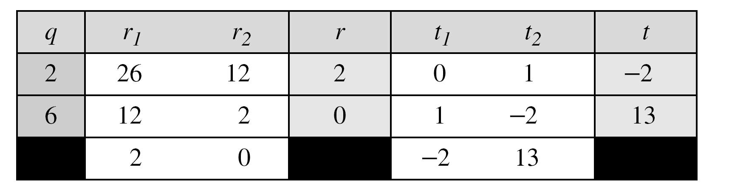
2.2.5 Continued
Example 2.27
Find the inverse of 12 in Z₂₆.
Solution
The gcd (26, 12) is 2; the inverse does not exist.

Slide 115
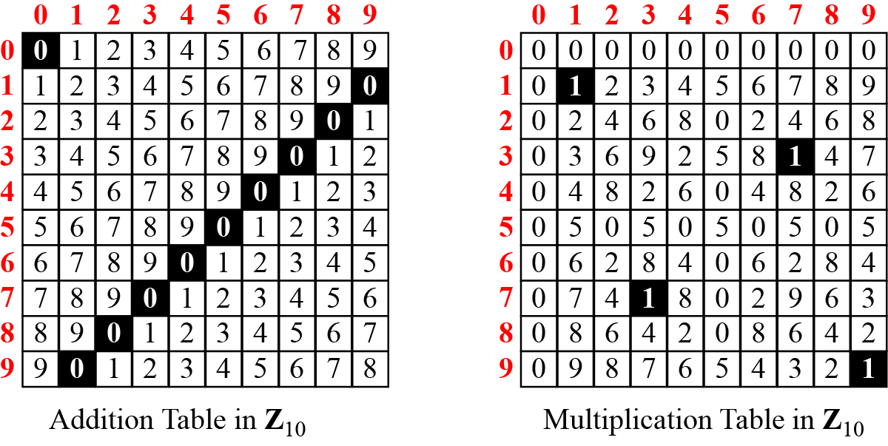
2.2.6 Addition and Multiplication Tables
Figure 2.16 Addition and multiplication table for Z₁₀

Slide 116
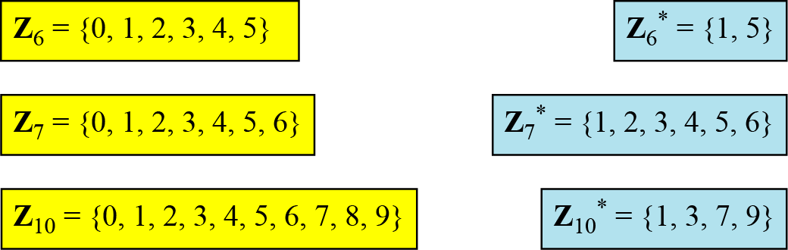
2.2.7 Different Sets
Figure 2.17 Some Z_{n} and Z_{n}* sets
Note
We need to use Zn when additive inverses are needed; we need to use Zn* when multiplicative inverses are needed.

Slide 117
2.2.8 Two More Sets
Cryptography often uses two more sets: Z_{p} and Z_{p}*. The modulus in these two sets is a prime number.

Slide 118
2-3 MATRICES
In cryptography we need to handle matrices. Although this topic belongs to a special branch of algebra called linear algebra, the following brief review of matrices is necessary preparation for the study of cryptography.
Topics discussed in this section:
2.3.1 Definitions 2.3.2 Operations and Relations 2.3.3 Determinants
2.3.4 Residue Matrices

Slide 119
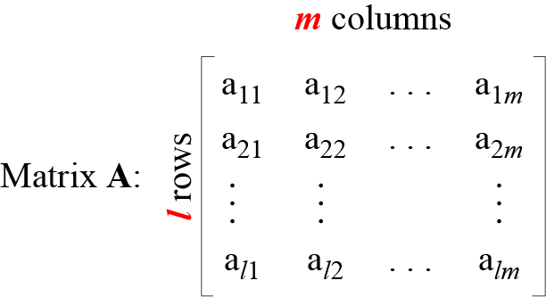
2.3.1 Definition
Figure 2.18 A matrix of size l × m

Slide 120
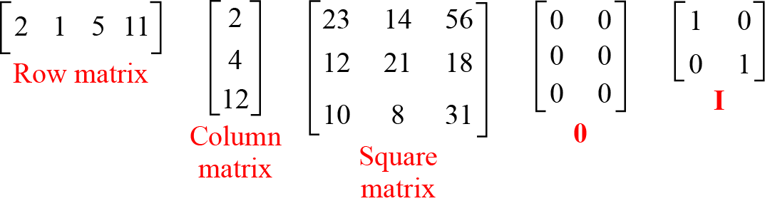
2.3.1 Continued
Figure 2.19 Examples of matrices

Slide 121
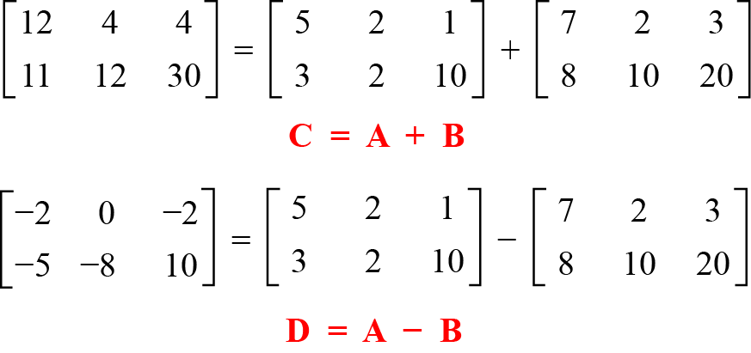
2.3.2 Operations and Relations
Example 2.28
Figure 2.20 shows an example of addition and subtraction.
Figure 2.20 Addition and subtraction of matrices

Slide 122
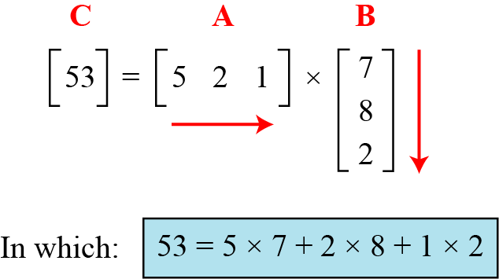
2.3.2 Continued
Example 2. 29
Figure 2.21 shows the product of a row matrix (1 × 3) by a column matrix (3 × 1). The result is a matrix of size 1 × 1.
Figure 2.21 Multiplication of a row matrix by a column matrix

Slide 123
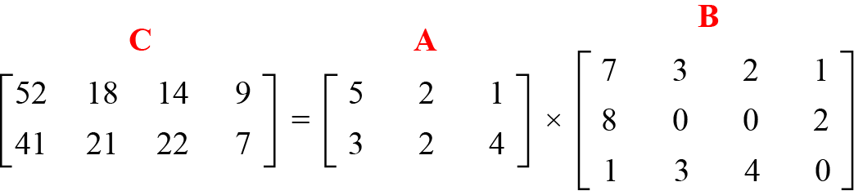
2.3.2 Continued
Example 2. 30
Figure 2.22 shows the product of a 2 × 3 matrix by a 3 × 4 matrix. The result is a 2 × 4 matrix.
Figure 2.22 Multiplication of a 2 × 3 matrix by a 3 × 4 matrix

Slide 124
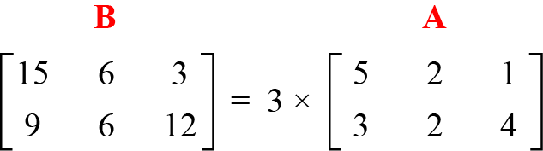
2.3.2 Continued
Example 2. 31
Figure 2.23 shows an example of scalar multiplication.
Figure 2.23 Scalar multiplication

Slide 125
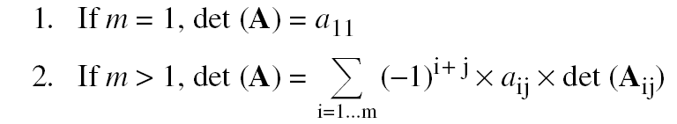
2.3.3 Determinant
The determinant of a square matrix A of size m × m denoted as det (A) is a scalar calculated recursively as shown below:
Note
The determinant is defined only for a square matrix.

Slide 126

2.3.3 Continued
Example 2. 32
Figure 2.24 shows how we can calculate the determinant of a 2 × 2 matrix based on the determinant of a 1 × 1 matrix.
Figure 2.24 Calculating the determinant of a 2 × 2 matrix

Slide 127

2.3.3 Continued
Example 2. 33
Figure 2.25 shows the calculation of the determinant of a 3 × 3 matrix.
Figure 2.25 Calculating the determinant of a 3 × 3 matrix

Slide 128
2.3.4 Inverses
Note
Multiplicative inverses are only defined for square matrices.

Slide 129

2.3.5 Residue Matrices
Cryptography uses residue matrices: matrices where all elements are in Z_{n}. A residue matrix has a multiplicative inverse if gcd (det(A), n) = 1.
Example 2. 34
Figure 2.26 A residue matrix and its multiplicative inverse

Slide 130
2-4 LINEAR CONGRUENCE
Cryptography often involves solving an equation or a set of equations of one or more variables with coefficient in Z_{n}. This section shows how to solve equations when the power of each variable is 1 (linear equation).
Topics discussed in this section:
2.4.1 Single-Variable Linear Equations 2.4.2 Set of Linear Equations

Slide 131

2.4.1 Single-Variable Linear Equations
Equations of the form ax ≡ b (mod n ) might have no solution or a limited number of solutions.

Slide 132
2.4.1 Continued
Example 2.35
Solve the equation 10 x ≡ 2(mod 15).
Solution
First we find the gcd (10 and 15) = 5. Since 5 does not divide 2, we have no solution.
Example 2.36
Solve the equation 14 x ≡ 12 (mod 18).
Solution

Slide 133
2.4.1 Continued
Example 2.37
Solve the equation 3x + 4 ≡ 6 (mod 13).
Solution
First we change the equation to the form ax ≡ b (mod n). We add −4 (the additive inverse of 4) to both sides, which give 3x ≡ 2 (mod 13). Because gcd (3, 13) = 1, the equation has only one solution, which is x₀ = (2 × 3⁻¹) mod 13 = 18 mod 13 = 5. We can see that the answer satisfies the original equation: 3 × 5 + 4 ≡ 6 (mod 13).

Slide 134

2.4.2 Single-Variable Linear Equations
We can also solve a set of linear equations with the same modulus if the matrix formed from the coefficients of the variables is invertible.
Figure 2.27 Set of linear equations

Slide 135
2.4.2 Continued
Example 2.38
Solve the set of following three equations:
Solution
The result is x ≡ 15 (mod 16), y ≡ 4 (mod 16), and z ≡ 14 (mod 16). We can check the answer by inserting these values into the equations.

Slide 136
Section 2
Traditional Symmetric-Key Ciphers

Slide 137
Objectives
❏ To define the terms and the concepts of symmetric key ciphers
❏ To emphasize the two categories of traditional ciphers: substitution and transposition ciphers
❏ To describe the categories of cryptanalysis used to break the symmetric ciphers
❏ To introduce the concepts of the stream ciphers and block ciphers
❏ To discuss some very dominant ciphers used in the past, such as the Enigma machine

Slide 138
3-1 INTRODUCTION
Figure 3.1 shows the general idea behind a symmetric-key cipher. The original message from Alice to Bob is called plaintext; the message that is sent through the channel is called the ciphertext. To create the ciphertext from the plaintext, Alice uses an encryption algorithm and a shared secret key. To create the plaintext from ciphertext, Bob uses a decryption algorithm and the same secret key.
Topics discussed in this section:
3.1.1 Kerckhoff’s Principle 3.1.2 Cryptanalysis 3.1.3 Categories of Traditional Ciphers

Slide 139

3.1 Continued
Figure 3.1 General idea of symmetric-key cipher

Slide 140
3.1 Continued
If P is the plaintext, C is the ciphertext, and K is the key,
We assume that Bob creates P₁; we prove that P₁ = P:

Slide 141

3.1 Continued
Figure 3.2 Locking and unlocking with the same key

Slide 142
3.1.1 Kerckhoff’s Principle
Based on Kerckhoff’s principle, one should always assume that the adversary, Darth, knows the encryption/decryption algorithm. The resistance of the cipher to attack must be based only on the secrecy of the key.

Slide 143

3.1.2 Cryptanalysis
As cryptography is the science and art of creating secret codes, cryptanalysis is the science and art of breaking those codes.
Figure 3.3 Cryptanalysis attacks

Slide 144

3.1.2 Continued
Ciphertext-Only Attack
Figure 3.4 Ciphertext-only attack

Slide 145

3.1.2 Continued
Known-Plaintext Attack
Figure 3.5 Known-plaintext attack

Slide 146

3.1.2 Continued
Chosen-Plaintext Attack
Figure 3.6 Chosen-plaintext attack

Slide 147

3.1.2 Continued
Chosen-Ciphertext Attack
Figure 3.7 Chosen-ciphertext attack

Slide 148
3-2 SUBSTITUTION CIPHERS
A substitution cipher replaces one symbol with another. Substitution ciphers can be categorized as either monoalphabetic ciphers or polyalphabetic ciphers.
Note
A substitution cipher replaces one symbol with another.
Topics discussed in this section:
3.2.1 Monoalphabetic Ciphres 3.2.2 Polyalphabetic Ciphers

Slide 149
3.2.1 Monoalphabetic Ciphers
Note
In monoalphabetic substitution, the relationship between a symbol in the plaintext to a symbol in the ciphertext is always one-to-one.

Slide 150
3.2.1 Continued
Example 3.1
The following shows a plaintext and its corresponding ciphertext. The cipher is probably monoalphabetic because both l’s (els) are encrypted as O’s.
Example 3.2
The following shows a plaintext and its corresponding ciphertext. The cipher is not monoalphabetic because each l (el) is encrypted by a different character.

Slide 151

3.2.1 Continued
Additive Cipher
The simplest monoalphabetic cipher is the additive cipher. This cipher is sometimes called a shift cipher and sometimes a Caesar cipher, but the term additive cipher better reveals its mathematical nature.
Figure 3.8 Plaintext and ciphertext in Z₂₆

Slide 152

3.2.1 Continued
Figure 3.9 Additive cipher
Note
When the cipher is additive, the plaintext, ciphertext, and key are integers in Z₂₆.

Slide 153
3.2.1 Continued
Example 3.3
Use the additive cipher with key = 15 to encrypt the message “hello”.
Solution
We apply the encryption algorithm to the plaintext, character by character:

Slide 154
3.2.1 Continued
Example 3.4
Use the additive cipher with key = 15 to decrypt the message “WTAAD”.
Solution
We apply the decryption algorithm to the plaintext character by character:

Slide 155
3.2.1 Continued
Shift Cipher and Caesar Cipher
Historically, additive ciphers are called shift ciphers. Julius Caesar used an additive cipher to communicate with his officers. For this reason, additive ciphers are sometimes referred to as the Caesar cipher. Caesar used a key of 3 for his communications.
Note
Additive ciphers are sometimes referred to as shift ciphers or Caesar cipher.

Slide 156
3.2.1 Continued
Example 3.5
Eve has intercepted the ciphertext “UVACLYFZLJBYL”. Show how she can use a brute-force attack to break the cipher.
Solution
Eve tries keys from 1 to 7. With a key of 7, the plaintext is “not very secure”, which makes sense.

Slide 157


3.2.1 Continued
Table 3.1 Frequency of characters in English
Table 3.2 Frequency of diagrams and trigrams

Slide 158
3.2.1 Continued
Example 3.6
Eve has intercepted the following ciphertext. Using a statistical attack, find the plaintext.
Solution
When Eve tabulates the frequency of letters in this ciphertext, she gets: I =14, V =13, S =12, and so on. The most common character is I with 14 occurrences. This means key = 4.

Slide 159

3.2.1 Continued
Multiplicative Ciphers
Figure 3.10 Multiplicative cipher
Note
In a multiplicative cipher, the plaintext and ciphertext are integers in Z₂₆; the key is an integer in Z26*.

Slide 160
3.2.1 Continued
Example 3.7
What is the key domain for any multiplicative cipher?
Solution
The key needs to be in Z₂₆*. This set has only 12 members: 1, 3, 5, 7, 9, 11, 15, 17, 19, 21, 23, 25.
Example 3.8
We use a multiplicative cipher to encrypt the message “hello” with a key of 7. The ciphertext is “XCZZU”.

Slide 161


3.2.1 Continued
Affine Ciphers
Figure 3.11 Affine cipher

Slide 162

3.2.1 Continued
Example 3.09
The affine cipher uses a pair of keys in which the first key is from Z₂₆* and the second is from Z₂₆. The size of the key domain is 26 × 12 = 312.
Example 3.10
Use an affine cipher to encrypt the message “hello” with the key pair (7, 2).

Slide 163

3.2.1 Continued
Example 3.11
Use the affine cipher to decrypt the message “ZEBBW” with the key pair (7, 2) in modulus 26.
Solution

Slide 164
3.2.1 Continued
Monoalphabetic Substitution Cipher
Because additive, multiplicative, and affine ciphers have small key domains, they are very vulnerable to brute-force attack.
A better solution is to create a mapping between each plaintext character and the corresponding ciphertext character. Alice and Bob can agree on a table showing the mapping for each character.
Figure 3.12 An example key for monoalphabetic substitution cipher

Slide 165
3.2.1 Continued
Example 3.13
We can use the key in Figure 3.12 to encrypt the message
The ciphertext is

Slide 166

3.2.2 Polyalphabetic Ciphers
In polyalphabetic substitution, each occurrence of a character may have a different substitute. The relationship between a character in the plaintext to a character in the ciphertext is one-to-many.
Autokey Cipher

Slide 167
3.2.2 Continued
Example 3.14
Assume that Alice and Bob agreed to use an autokey cipher with initial key value k1 = 12. Now Alice wants to send Bob the message “Attack is today”. Enciphering is done character by character.

Slide 168


3.2.2 Continued
Playfair Cipher
Figure 3.13 An example of a secret key in the Playfair cipher
Example 3.15
Let us encrypt the plaintext “hello” using the key in Figure 3.13.

Slide 169
3.2.2 Continued
Vigenere Cipher
Example 3.16
We can encrypt the message “She is listening” using the 6-character keyword “PASCAL”.

Slide 170
3.2.2 Continued
Example 3.16
Let us see how we can encrypt the message “She is listening” using the 6-character keyword “PASCAL”. The initial key stream is (15, 0, 18, 2, 0, 11). The key stream is the repetition of this initial key stream (as many times as needed).

Slide 171

3.2.2 Continued
Example 3.17
Vigenere cipher can be seen as combinations of m additive ciphers.
Figure 3.14 A Vigenere cipher as a combination of m additive ciphers

Slide 172

3.2.2 Continued
Example 3.18
Using Example 3.18, we can say that the additive cipher is a special case of Vigenere cipher in which m = 1.
Table 3.3
A Vigenere Tableau

Slide 173
3.2.2 Continued
Vigenere Cipher (Crypanalysis)
Example 3.19
Let us assume we have intercepted the following ciphertext:
The Kasiski test for repetition of three-character segments yields the results shown in Table 3.4.

Slide 174
3.2.2 Continued
Example 3.19
Let us assume we have intercepted the following ciphertext:
The Kasiski test for repetition of three-character segments yields the results shown in Table 3.4.

Slide 175

3.2.2 Continued
Example 3.19
(Continued)
The greatest common divisor of differences is 4, which means that the key length is multiple of 4. First try m = 4.
In this case, the plaintext makes sense.

Slide 176

3.2.2 Continued
Hill Cipher
Figure 3.15 Key in the Hill cipher
Note
The key matrix in the Hill cipher needs to have a multiplicative inverse.

Slide 177

3.2.2 Continued
Example 3.20
For example, the plaintext “code is ready” can make a 3 × 4 matrix when adding extra bogus character “z” to the last block and removing the spaces. The ciphertext is “OHKNIHGKLISS”.
Figure 3.16 Example 3.20

Slide 178

3.2.2 Continued
Example 3.21
Assume that Eve knows that m = 3. She has intercepted three plaintext/ciphertext pair blocks (not necessarily from the same message) as shown in Figure 3.17.
Figure 3.17 Example 3.21

Slide 179

3.2.2 Continued
Example 3.21
(Continued)
She makes matrices P and C from these pairs. Because P is invertible, she inverts the P matrix and multiplies it by C to get the K matrix as shown in Figure 3.18.
Figure 3.18 Example 3.21
Now she has the key and can break any ciphertext encrypted with that key.

Slide 180
3.2.2 Continued
One-Time Pad
One of the goals of cryptography is perfect secrecy. A study by Shannon has shown that perfect secrecy can be achieved if each plaintext symbol is encrypted with a key randomly chosen from a key domain. This idea is used in a cipher called one-time pad, invented by Vernam.

Slide 181

3.2.2 Continued
Rotor Cipher
Figure 3.19 A rotor cipher

Slide 182

3.2.2 Continued
Enigma Machine
Figure 3.20 A schematic of the Enigma machine

Slide 183
3-3 TRANSPOSITION CIPHERS
A transposition cipher does not substitute one symbol for another, instead it changes the location of the symbols.
Note
A transposition cipher reorders symbols.
Topics discussed in this section:
3.3.1 Keyless Transposition Ciphers 3.3.2 Keyed Transposition Ciphers 3.3.3 Combining Two Approaches

Slide 184
3.3.1 Keyless Transposition Ciphers
Simple transposition ciphers, which were used in the past, are keyless.
Example 3.22
A good example of a keyless cipher using the first method is the rail fence cipher. The ciphertext is created reading the pattern row by row. For example, to send the message “Meet me at the park” to Bob, Alice writes
She then creates the ciphertext “MEMATEAKETETHPR”.

Slide 185
3.3.1 Continued
Example 3.23
Alice and Bob can agree on the number of columns and use the second method. Alice writes the same plaintext, row by row, in a table of four columns.
She then creates the ciphertext “MMTAEEHREAEKTTP”.

Slide 186
3.3.1 Continued
Example 3.24
The cipher in Example 3.23 is actually a transposition cipher. The following shows the permutation of each character in the plaintext into the ciphertext based on the positions.
The second character in the plaintext has moved to the fifth position in the ciphertext; the third character has moved to the ninth position; and so on. Although the characters are permuted, there is a pattern in the permutation: (01, 05, 09, 13), (02, 06, 10, 13), (03, 07, 11, 15), and (08, 12). In each section, the difference between the two adjacent numbers is 4.

Slide 187
3.3.2 Keyed Transposition Ciphers
The keyless ciphers permute the characters by using writing plaintext in one way and reading it in another way The permutation is done on the whole plaintext to create the whole ciphertext. Another method is to divide the plaintext into groups of predetermined size, called blocks, and then use a key to permute the characters in each block separately.

Slide 188
3.3.2 Continued
Example 3.25
Alice needs to send the message “Enemy attacks tonight” to Bob..
The key used for encryption and decryption is a permutation key, which shows how the character are permuted.
The permutation yields

Slide 189

3.3.3 Combining Two Approaches
Example 3.26
Figure 3.21

Slide 190

3.3.3 Continued
Keys
In Example 3.27, a single key was used in two directions for the column exchange: downward for encryption, upward for decryption. It is customary to create two keys.
Figure 3.22 Encryption/decryption keys in transpositional ciphers

Slide 191

3.3.3 Continued
Figure 3.23 Key inversion in a transposition cipher

Slide 192

3.3.3 Continued
Using Matrices
We can use matrices to show the encryption/decryption process for a transposition cipher.
Example 3.27
Figure 3.24 Representation of the key as a matrix in the transposition cipher

Slide 193
3.3.3 Continued
Example 3.27
Figure 3.24 shows the encryption process. Multiplying the 4 × 5 plaintext matrix by the 5 × 5 encryption key gives the 4 × 5 ciphertext matrix.
Figure 3.24 Representation of the key as a matrix in the transposition cipher

Slide 194

3.3.3 Continued
Double Transposition Ciphers
Figure 3.25 Double transposition cipher

